Slide 1
OS’26-27 Project
PART III: INDIVIDUAL MODULES
(fault handler ii, USER HEAP, CPU SCHED, IPC, SHARED MEMORY)

Slide 2
Agenda
PART 0: ROADMAP
PART I: PREREQUISITES
PART II: GROUP MODULES
PART III: INDIVIDUAL MODULES
PART IV: OVERALL TESTING & BONUSES

Slide 3
Agenda
PART II: INDIVIDUAL MODULES
  Fault Handler II (Replacement)
  User Heap
  CPU Scheduling
  Inter-process Communication #1
  Inter-process Communication #2
  Shared Memory

Slide 4

Fault Handler II (Replace)
PART III: INDIVIDUAL module #1

Slide 5
Project Overview
[TW] Prerequisite Modules
Dyn. Alloc, Kern Heap, Fault Handl. 1, Blocking
[M#1]
Fault Handl. 2
[M#5]
IPC #2
Individual Module#1
Individual Module#2
[M#2]
User Heap
Individual Module#3
Individual Module#4
[M#6]
Shared Memory
[M#3]
CPU Sched.
[M#4]
IPC #1
[TW] Integration & Overall Testing
Scenarios & Bonuses
Notes:
Inshaa’ALLAH

Slide 6
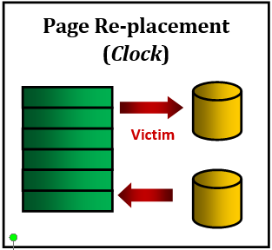
Objective
Handle the page fault exception by choosing a victim page to be replaced with the faulted page
(N^{th} Chance CLK)

Slide 7
Fault Handler II
DEPENDENCIES: Kernel Heap + Fault Handler I

Slide 8
Fault Handler II: Replacement
The main functions required by MS3 to handle “Page Fault” are:
# | Function | File
1 | page_fault_handler | Functions definitions TO DO in: kern/trap/fault_handler.c

Slide 9
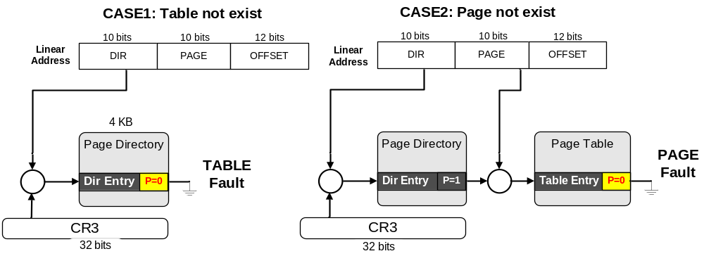
Fault Handler II: Introduction
Fault: is an exception thrown by the processor (MMU) to indicate that:
  A page table is not exist in the main memory (i.e. new table). (see the following figure) OR
  A page can’t be accessed due to either it’s not present in the main memory

Slide 10
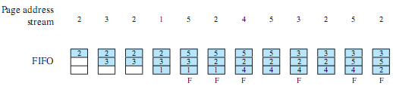
Replac#1: FIFO – Idea
  Treats allocated frames as a circular buffer
  Pages are removed in round-robin style
  Adv: Simplest to implement
  DisAdv: first-loaded pages may be needed again very soon
Notes:
The first-in-first-out (FIFO) policy treats the page frames allocated to a process as a circular buffer, and pages are removed in round-robin style.
All that is required is a pointer that circles through the page frames of the process.
This is one of the simplest page replacement policies to implement.
The logic behind this choice is that one is replacing the page that has been in memory the longest:
A page fetched into memory a long time ago may have now fallen out of use.
This reasoning will often be wrong, because there will often be regions of program or data that are heavily used throughout the life of a program.
Those pages will be repeatedly paged in and out by the FIFO algorithm.

Slide 11
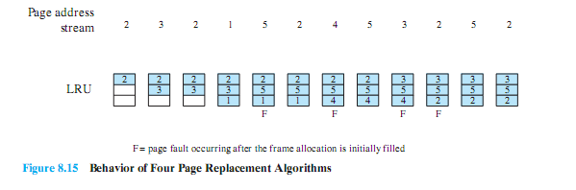
Replac#2: LRU – Idea#1
Replaces the page that has not been referenced for the longest time.
  Adv: BEST feasible
  Probs: Difficult to implement .. WHY??
    HOW do you tag each page with the time of last reference to be able to implement LRU.

Slide 12
Replac#2: LRU – Idea#1
So, how to implement LRU?
  On each use, remove page from list and place at head
  LRU page is at tail
Use a list!
Head
Tail
(LRU)

Slide 13

Replac#2: LRU – Idea#1
Example - If we have the following references:
  Page 2:
  (Page Fault)
  Page 1:
  (Page Fault)
  Page 6:
  (Page Fault)
  Page 1:
  (ACCESS already
  Existing page)
Use a list!
Head
P2
Tail
(LRU)
Head
Head
P1
P2
Tail
(LRU)
Tail
(LRU)
Problems?
Need to know immediately when each page used so that can change position in list…
Head
P6
P1
P2
Tail
(LRU)
Head
P6
P2
Head
P1
P6
P2
Tail
(LRU)
Tail
(LRU)

Slide 14
Replac#2: LRU – Idea#1
So, to implement LRU with know immediately when each page used:
  Page 2:
  (Page Fault)
  Page 1:
  (Page Fault)
  Page 6:
  (Page Fault)
  Page 1:
  (ACCESS already
  Existing page)
Head
P2
Tail
(LRU)
Solution ?!!
  With handling each page fault, MARK all pages as NOT present, even if in memory, except the FAULTED one (head)
  So, on reading a NOT present page, trap to OS (fault handler) to control ..
  That’s what we need ☺
P = 0
Head
P1
P2
Tail
(LRU)
P = 0
P = 0
Head
P6
P1
P2
Page
Fault
Tail
(LRU)
This is known as: PERFECT LRU
Head
P1
P6
P2
Tail
(LRU)

Slide 15
Replac#2: LRU – Idea#1
Disadvantages ?!!
  Page fault exception with each access to a page (either exists or not).. So, for each user reference:
    CPU will be switched from user to kernel mode to handle the page fault
    (1 reference -> execute code)
    Increase time required to handle ONE page access
    Increase overhead in the memory access.
Solution ?!!
  With handling each page fault, MARK all pages as NOT present, even if in memory, except the FAULTED one (head)
  So, on reading a NOT present page, trap to OS (fault handler) to control ..
  That’s what we need ☺
This is known as: PERFECT LRU

Slide 16
Replac#2: LRU – Idea#2: List Approx
Linked LIST 1:
Directly Mapped Pages
Marked: PRESENT
List: FIFO
Linked LIST 2:
Second Chance List
Marked: NOT PRESENT
List: LRU
New
Active
Pages
New
SC
Victims
Remember:
This approach is an approximation to the PERFECT LRU to avoid its disadvantages
But HOW?

Slide 17
Replac#2: LRU – Idea#2: List Approx
Assume we have the following references with 2 EMPTY lists:
LIST 1:
Directly Mapped Pages
Max Size = 3
LIST 2:
Second Chance List
Max Size = 3
5- P5
6- P6
4- P4
3- P3
2- P2
1-P1
P1
So, for each page fault, add it in LIST 1
When LIST 1 is FULL:
  Remove a page from LIST 1 using FIFO
  Place the removed page at the head of LIST 2
  Place the new faulted page at the head of LIST 1
P4
P2
P1
P3
P1
P1
List 1 is FULL!!
Overflow
P5
P1
P2
P1
P3
P4
P1
P2
P1
P2
Then, apply FIFO
P6
P3
P3
P4
P5
P2
P2
Head
P1
P1
P = 1
P = 0
Page-in
From disk
New
Active
Pages
New
SC
Victims

Slide 18
Replac#2: LRU – Idea#2: List Approx
Now, the 2 lists are FULL, and a new FAULT is happened:
LIST 1:
Directly Mapped Pages
Max Size = 3
LIST 2:
Second Chance List
Max Size = 3
7- P7
P1
P4
P5
P2
P1
P3
P1
P1
P2
LRU victim
Overflow
P5
P1
P2
P1
P3
P3
P6
P4
P1
P2
P1
P2
Extract the LRU page from LIST 2 If Modified ➔ write it to DISK
Read faulted page from DISK
P3
P7
P1
Head
P6
P4
P = 1
P = 0
New
Active
Pages
New
SC
Victims
Page-in
From disk
MODIFIED Page
To Disk

Slide 19
Replac#2: LRU – Idea#2: List Approx
Now, access to already existing page is happened:
LIST 1:
Directly Mapped Pages
Max Size = 3
LIST 2:
Second Chance List
Max Size = 3
8- P3
P5
P6
P2
P1
P1
P4
P5
P2
P1
P3
P4
P1
P3
P2
P1
P1
P1
P2
Marked: PRESENT
List: FIFO
Overflow
Marked:
NOT PRESENT
List: LRU
P7
P1
P5
P6
P2
P1
P3
P4
P4
P5
P3
P3
P2
P1
P4
P1
P2
P1
P2
P7
Access
P3
P3
P5
P4
P5
P3
P2
P1
P1
Head
P4
P = 1
P = 0
New
Active
Pages
New
SC
Victims
Page-in
From disk
Page to
disk

Slide 20
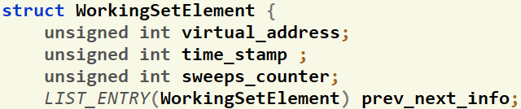

Repl.: Given Data
IMP. NOTE: you should maintain the page_last_WS_element, Correct FIFO Order & Content of BOTH Lists in rest of code (page_fault_handler, free_user_mem …)
inc/environment_definitions.h
struct Env
{
struct WS_List page_WS_active_list; //ActiveList that should work as FIFO
struct WS_List page_WS_second_list; //SecondList that should work as LRU
int page_WS_max_size ; //Max allowed WS Size for both Lists
int page_2nd_WS_size ; //Max allowed size of SecondList
struct WorkingSetElement* page_last_WS_element;
Each Element
Proc Limit
LRU 2nd List
Each process has two working set LISTs that are initialized in env_create()
The max total size is set in "page_WS_max_size" during the env_create()
"page_2nd_WS_size" will hold the max size of the 2nd list (in case of FIFO, it equals ZERO)
"page_last_WS_element" will point to either:
  First location in the Active WS If the list is full.
  Null if the list is not full.
inc/environment_definitions.h
This list hold pointers to struct containing info about the currently loaded pages in memory.
Each struct holds important values about each page:
  User virtual address of the page
  Previous & Next pointers to be used by list

Slide 21
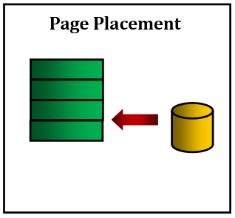
#1: FIFO Replacement
Refer to APPENDICES for:
Page File Helper Functions
(FIFO)
Working Set Structure & Helper Functions
page_fault_handler(struct Env * curenv, uint32 fault_va)
  if the size of both WS Lists < max total size, then do
  {
  Scenario 1: Placement //[DONE in GROUP MODULE]: PAGE FAULT HANDLER – FIFO Placement
  }
else
  {
if(isPageReplacmentAlgorithmFIFO())
{
Scenario 2: FIFO Replacement
  //TODO: PAGE FAULT HANDLER - FIFO Replacement
  }
}

Slide 22
#2: LRU Placement
Page Placement
OR
page_fault_handler(struct Env * curenv, uint32 fault_va)
  if the size of both WS Lists < max total size, then do
  {
if(isPageReplacmentAlgorithmFIFO())
{ ...}
else (isPageReplacmentAlgorithmLRU(PG_REP_LRU_LISTS_APPROX))
{
Scenario 1: Placement //PAGE FAULT HANDLER – LRU Placement
//Handle the following TWO cases:
1. If active list is FULL, move the overflow element to the 2nd list
2. If the faulted page in the 2nd list, move it to the active list & handle the overflow
  }
}

Slide 23
#3: LRU Replacement
Refer to APPENDICES for:
Page File Helper Functions
Page Placement
Page Replacement (LRU Approx)
Working Set Structure & Helper Functions
OR
modified
page_fault_handler(struct Env * curenv, uint32 fault_va)
  ...
  else //the size of both WS Lists == max total size, then do
  {
if(isPageReplacmentAlgorithmFIFO())
{ ...}
else if(isPageReplacmentAlgorithmLRU(PG_REP_LRU_LISTS_APPROX))
{
Scenario 2: LRU Replacement
  //TODO: PAGE FAULT HANDLER - LRU Replacement
  }
}

Slide 24
Page Fault Handler: Switching…
To switch the replacement from the FOS prompt:
  FOS> lru 2 ➔ switch the replacement to LRU List Approx.
  FOS> fifo ➔ switch the replacement to FIFO
To switch the replacement from the code:
  Inside the fault_handler_init() in “kern/trap/fault_handler.c”:
    setPageReplacmentAlgorithmLRU(PG_REP_LRU_LISTS_APPROX); ➔ set LRU List Approx. replacement
    setPageReplacmentAlgorithmFIFO(); ➔ set FIFO replacement

Slide 25
User Heap
PART III: INDIVIDUAL module #2

Slide 26
Project Overview
[TW] Prerequisite Modules
Dyn. Alloc, Kern Heap, Fault Handl. 1, Blocking
[M#1]
Fault Handl. 2
[M#5]
IPC #2
Individual Module#1
Individual Module#2
[M#2]
User Heap
Individual Module#3
Individual Module#4
[M#6]
Shared Memory
[M#3]
CPU Sched.
[M#4]
IPC #1
[TW] Integration & Overall Testing
Scenarios & Bonuses
Notes:
Inshaa’ALLAH

Slide 27
Objective
Allow the user process to dynamically allocate/free data of different sizes in run-time

Slide 28
User Heap
DEPENDENCIES
Dynamic Allocator + Fault Handler I

Slide 29
User Heap – Functions
The main functions required to handle “User Heap” are:
# | Function | File
1 | create_buddy_space | Decl.: inc/dynamic_allocator.h definitions: lib/uheap.c
2 | delete_buddy_space
3 | malloc (CUSTOM FIT) [USER SIDE] | declarations: inc/uheap.h definitions: lib/uheap.c
4 | free [USER SIDE]
5 | allocate_user_mem [KERNEL SIDE] | Kern/mem/chunk_operations.c
6 | free_user_mem [KERNEL SIDE]

Slide 30
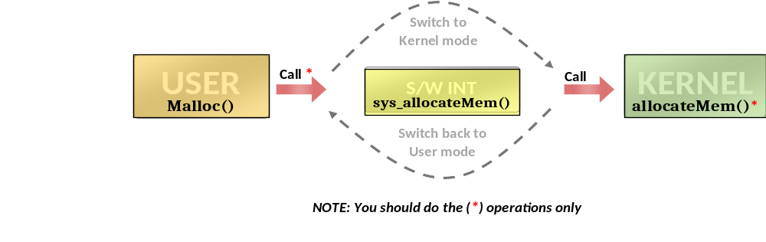
User Heap: Overview
Before we start!
  Program runs in user mode (less privileges)
  It requires functions from the kernel
  So, need to switch to kernel mode, call the function, then return to user mode
  SYSTEM CALLS (S/W interrupts) do this job!

Slide 31
User Heap: Overview
Allocation
  Example 1 (C++ and C):
    C++: int * ptr_value = new int;
    C: int * ptr_value = malloc(sizeof(int));
    allocate 1 int (4 bytes) in virtual memory and return the allocated virtual address to “ptr_value”
  Example 2 (C++ and C):
    C++: float* arr = new float[200];
    C: float* arr = malloc(sizeof(float) * 200);
    allocate 200 floats (800 bytes) in memory and return the allocated address to “arr”

Slide 32
User Heap: Overview
De-allocation
  Example 1 (C++ and C):
    C++: delete ptr_value;
    C: free(ptr_value);
    deallocate (free) 1 int (4 bytes) from virtual memory at address “ptr_value”
  Example 2 (C++ and C):
    C++: delete[] arr;
    C: free(arr);
    de-allocate (free) 200 floats (800 bytes) from virtual memory at address “arr”

Slide 33
User Heap: Overview
User Dynamic malloc/free *
malloc( )
(CUSTOM Fit)
free( )
Nothing Created in Memory
REMOVE Working Sets Pages in Given Range
REMOVE ALL Pages in Given Range
UN-MARK allocated pages in VM
Nothing Created in Page File
MARK allocated pages in VM
USE PERM_UHPAGE TO UN/MARK PAGES

Slide 34
User Heap – Allocation Types?
LAZY ALLOCATOR: NOTHING is actually allocated in RAM until the user access it. In this case, allocation will be done via Fault Handler
There’re TWO types of allocator
Block Allocator
  Used to allocate small blocks (with size LESS OR EQUAL DYN_ALLOC_MAX_BLOCK_SIZE)
  Use Buddy System Functions
  Use Page Allocator to allocate/free pages of the Buddy System
Page Allocator
  Used to allocate chunk of pages (with size > DYN_ALLOC_MAX_BLOCK_SIZE )
  Allocation is done on page boundaries (i.e. internal fragmentation)
Range of both:
    USED Area: [USER_HEAP_START, PAGE ALLOC BREAK)
    UNUSED Area: [PAGE ALLOC BREAK , USER_HEAP_MAX)
USER_HEAP_MAX
…
UNUSED
USER HEAP
Page Alloc BREAK
USED
USER_HEAP_START
…

Slide 35
User Heap – Block Allocator
Use Buddy System with its data structure
The lists of the Buddy System are already initialized inside buddy_init() which is called inside:
int uheap_init(…) defined in lib/uheap.c
This function, in turn, is already called in malloc()
Use Page Allocator to allocate/free pages of the Buddy System
void* create_buddy_space();
void delete_buddy_space(void *va);

Slide 36
User Heap – Page Allocator
Allocation is done on page boundaries (multiple of 4KB)
  i.e. internal fragmentation can occur
NO pages will be allocated in RAM or Page File
Allocation Strategy: CUSTOM FIT
USER_HEAP_MAX
…
KERNEL HEAP
USER_HEAP_START
…

Slide 37
User Heap – Page Allocator
Has 2 limits defined in inc/uheap.h:
  uheapPageAllocStart: begin of page allocator area
  uheapPageAllocBreak: end of currently used area
malloc/free can move uheapPageAllocBreak up/down
USER_HEAP_MAX
…
UNUSED
KERNEL HEAP
uheapPageAllocBreak
USED
Page Alloc BREAK
USED
uheapPageAllocStart
USER_HEAP_START
…

Slide 38
User Heap – Page Allocator (malloc)
Allocate pages on 4KB granularity
.
.
.
ptr3 = malloc (3 KB)
ptr3
3 KB
ptr2 = malloc (2.1 KB)
ptr2
2.1 KB
1.5 KB
4 KB
ptr1 = malloc (5.5 KB)
ptr1
.
.
.

Slide 39
User Heap – Page Allocator (malloc)
USER_HEAP_MAX
.
.
.
UNUSED
ptr1 = malloc (1 MB)
UNUSED
CUSTOM FIT Strategy
1. Search for EXACT fit
2. if not found,
search for WORST fit till break
3. if not found,
extend BREAK if available
4. if not available,
return NULL
Required Complexity: bounded by
O(# FREE areas + # required pages)
ptr2 = malloc(1 MB)
ptr3 = malloc (3 MB)
uheapPageAllocBreak
ptr4 = malloc (1.5 MB)
2 MB
FREE
2 MB
ptr5
2.5 MB
ptr5 = malloc (2.5 MB)
1 MB
ptr1 = malloc (1 MB)
ptr1
1 MB
1 MB
1 MB
ptr3 = malloc (3 MB)
3 MB
ptr3
4 MB
ptr2 = malloc(1 MB)
ptr2
1 MB
2 MB
FREE
3 MB
ptr4 = malloc (1.5 MB)
ptr4
1.5 MB
4 MB
uheapPageAllocStart
x = malloc (12 KB)
O(2 + 12KB/4KB)

Slide 40
User Heap – Page Allocator (free)
KERNEL_HEAP_MAX
.
.
.
UNUSED
UNUSED
Make sure to:
1. Merge adjacent blocks
2. Update the uheapPageAllocBreak if freeing the last space
Required Complexity: bounded by
O(# FREE areas + # freed pages)
uheapPageAllocBreak
ptr5
2.5 MB
free (ptr5)
2 MB
FREE
2 MB
1 MB
free (ptr1)
ptr1
1 MB
1 MB
1 MB
FREE
4MB Free
3 MB
free (ptr3)
3MB Free
ptr3
4 MB
free (ptr2)
ptr2
1 MB
2 MB
FREE
3 MB
ptr4
1.5 MB
O(3 + 1.5MB/4KB)
4 MB
kfree (ptr4)
uheapPageAllocStart

Slide 41

User Heap – Given Functions
Refer to APPENDICES for:
LISTS Helper Macros
void uheap_init()
Description:
  Initialize the free block lists of Buddy System (by calling buddy_init())
  Get current strategy of page allocator (CUSTOM_FIT)
  Initialize uheapPageAllocStart & uheapPageAllocBreak to USER_HEAP_START

Slide 42
#1: create_buddy_space()
void* create_buddy_space()
lib/uheap.c
Description:
  Get a new page from the Page Allocator and return its address
  Mark this page as a “Buddy System Page” to differentiate it from Page Allocator pages

Slide 43
#2: delete_buddy_space()
void delete_buddy_space(void *va)
lib/uheap.c
Description:
  Delete the page at the given va from the Page Allocator
  Unmark it

Slide 44
#3: malloc()
void* malloc(unsigned int size)
Description:
  [USER SIDE] lib/uheap.c
  If size ≤ DYN_ALLOC_MAX_BLOCK_SIZE: [BLOCK ALLOCATOR]
    Use dynamic allocator to allocate the required space
    Possibly invoke the Page Allocator to create_buddy_space()
  Else: [PAGE ALLOCATOR]
    Implement CUSTOM FIT strategy to search the page allocator for suitable space to the required allocation size (space should be on 4 KB BOUNDARY)
    Call sys_allocate_user_mem() to mark the reserved space
  If failed to allocate: return NULL
  It should be bounded by O(# FREE areas)
lib/uheap.c
To access the environment data, use myEnv pointer

Slide 45
#4: allocate_user_mem()
void allocate_user_mem(struct Env* e, uint32 va, uint32 size)
Description:
  [KERNEL SIDE] kern/mem/chunk_operations.c:
  Mark the given range to indicate it’s reserved for page allocator of this environment (use PERM_UHPAGE)
  NOTE: you can use create_page_table() to create non-exiting tables (if any)
  It should be bounded by O(# pages)
Nothing Created in Memory
Nothing Created in Page File
MARK allocated pages in VM

Slide 46
#5: free()
void free(void* virtual_address)
Description:
  [USER SIDE] lib/uheap.c
  If the virtual address belong to a “Buddy System Page” [BLOCK ALLOCATOR]
    Use Buddy System to free the given address
    Possibly invoke the Page Allocator to delete_buddy_space()
  Else if virtual address inside the Heap [PAGE ALLOCATOR]
    Find the allocated size of the given virtual_address
    Free this allocation from the page allocator of the user heap
    Call “sys_free_user_mem()” to free the allocation from the memory & page file and UNMARK pages
  Else (i.e. invalid address): should panic(…)
  It should be bounded by O(# FREE areas)
To access the environment data, use myEnv pointer

Slide 47
#6: free_user_mem()
Refer to APPENDICES for:
Page File Helper Functions
Working Set Struct & Helper Func’s
void free_user_mem(struct Env* e, uint32 va, uint32 size)
Description:
  [KERNEL SIDE] kern/mem/chunk_operations.c:
  Unmark the given range to indicate it’s NOT reserved for the page allocator of this environment
  Free ALL pages of the given range from the Page File
  Free ONLY pages that are resident in the working set from the memory
  It should be bounded by O(# pages)
REMOVE Working Sets Pages in Given Range
REMOVE ALL Pages in Given Range
UN-MARK allocated pages in VM

Slide 48
CPU Scheduling
PART III: INDIVIDUAL module #3

Slide 49
Project Overview
[TW] Prerequisite Modules
Dyn. Alloc, Kern Heap, Fault Handl. 1, Blocking
[M#1]
Fault Handl. 2
[M#5]
IPC #2
Individual Module#1
Individual Module#2
[M#2]
User Heap
Individual Module#3
Individual Module#4
[M#6]
Shared Memory
[M#3]
CPU Sched.
[M#4]
IPC #1
[TW] Integration & Overall Testing
Scenarios & Bonuses
Notes:
Inshaa’ALLAH

Slide 50
Objective
Support Multi-level Feedback Queue (MLFQ) scheduling among user processes & avoid starvation

Slide 51
MLFQ Scheduler
REMEMBER
During your solution, any SHARED data need to be PROTECTED by critical section via LOCKS

Slide 52
MLFQ Scheduler
The main functions required to handle “MLFQ Scheduler” are:
# | Function | File
1 | sched_set_starv_thresh | kern/sched/sched_helpers.c
2 | sched_init_MLFQ | Functions definitions TO DO in: kern/sched/sched.c
3 | fos_scheduler_MLFQ
4 | clock_interrupt_handler

Slide 53


MLFQ Scheduler: Current Scheduling
Dynamic Peer Assignment
Process is moved from CPU to another
Each processor does self-scheduling
Round Robin Scheduling
Single ready queue
Each process is given a slice of time (quantum) on the specific CPU
When timeout, it’s preempted by clock interrupt and returned to RQ
CPU₁
Admit
P_{m}
…
P₂
P₁
CPU₂
.
.
.
CPU_{n}
Drawback: favor processor-bound processes over I/O-bound processes, which results:
  in poor performance for I/O-bound processes,
  inefficient use of I/O devices,
  an increase in the variance of response time.

Slide 54



MLFQ Scheduler: Overview
Refer to APPENDICES for:
CPU & Scheduler Functions
WHAT?
  multiple ready queues to represent each level of priority
  At any given time: the scheduler of any CPU chooses a process from the highest-priority non-empty queue.
  Preemptive on clock (different quantum per queue)
  Each subsequent time the process is preempted, it is demoted to the next lower-priority queue.
  Last level can run in 1-of-2 modes, based on the quantum
    preemptive manner (i.e. RR) (quantum > 0)
    non-preemptive manner (i.e. FCFS) (quantum = 0)
CPUs
Admit
…
P₄
P₁
…
P₁
P₄
…
P₆
P₂
…
.
.
.
Decreasing Priority
…
P₈
P₇
P₁
P₁₂
…
P₅
P₃
Exit/ Block

Slide 55
MLFQ Scheduler: Overview
Refer to APPENDICES for:
CPU & Scheduler Functions
Pros
  Shorter processes are favored over longer processes.
    A short process will complete quickly, without migrating very far down the hierarchy of ready queues.
    A longer process will gradually drift downward.
  Favor I/O-bound over processor-bound processes
    Efficient use of I/O devices
CPUs
Admit
…
P₄
P₁
…
P₄
…
P₆
P₂
…
.
.
.
Decreasing Priority
…
P₈
P₇
P₁₂
…
P₅
P₃
Exit/ Block

Slide 56
MLFQ Scheduler: Overview
Refer to APPENDICES for:
CPU & Scheduler Functions
Cons
  Longer processes may suffer starvation if there is a steady supply of new processes.
    Solution
    Allow a process to change its priority based on its age (IF WAITING TIME EXCEEDS CERTAIN THRESHOLD)
CPUs
Admit
…
P₄
P₁
…
P₄
…
P₆
P₂
…
.
.
.
Decreasing Priority
…
P₈
P₇
P₁₂
…
P₅
P₁₂
P₅
P₃
Exit/ Block

Slide 57
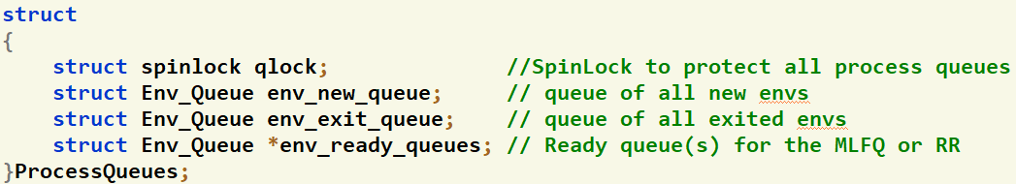
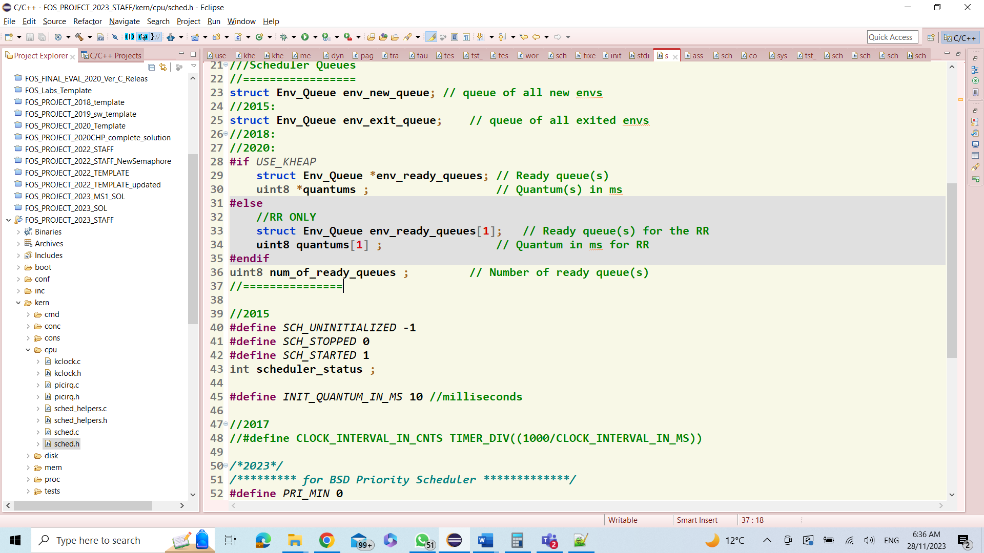
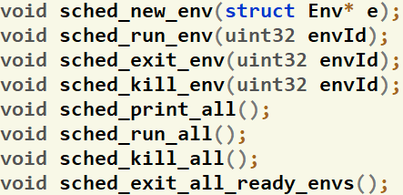
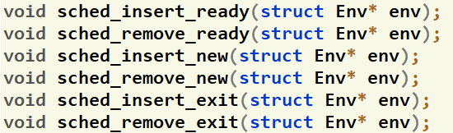
Given Data Structures & Functions
Refer to APPENDICES for:
CPU & Scheduler Fns
Queues
kern/cpu/sched.h
CPU Scheduler
Get Timestamp Counter
inc/x86.h
Sched Function
kern/cpu/sched_helpers.c
Queues Function
kern/cpu/sched_helpers.c
Insert process in the correspond. ready queue (based on its priority)

Slide 58

Given Commands
FOS> run <prog_name> <page_WS_size> [<2nd_WS_size>]
FOS> load <prog_name> <page_WS_size> [<2nd_WS_size>]
FOS> loadN <N> <prog_name> <page_WS_size> [<2nd_WS_size>]
FOS> setStarvThr <starvationThreshold>
FOS> runall
FOS> printall
FOS> sched?
Refer to APPENDICES for:
Ready-Made Commands

Slide 59
#1: Set Starvation Threshold
kern/cpu/sched_helpers.c
void sched_set_starv_thresh(uint32 starvThresh)
Description:
  Set the starvation threshold by the given value

Slide 60
#2: Initialize MLFQ Scheduler
Refer to APPENDICES for:
CPU & Scheduler Functions
void sched_init_MLFQ(uint8 numOfLevels, uint8* quantumOfEachLevel, uint32 starvThresh)
kern/cpu/sched.c
Description:
  Initialize the MLFQ scheduler by the given number of levels, CPU quantum of each level (in approx. ms) and starvation threshold
  Do other initializations (if any)
  Should set the following global variables for initialization (declared in kern/cpu/sched.h)

Slide 61
#3: Schedule Next Process
Refer to APPENDICES for:
CPU & Scheduler Functions
struct Env* fos_scheduler_MLFQ()
kern/cpu/sched.c
Description:
  If there’s a current process on the current CPU, place it in the corresponding ready queue (do any required initializations)
  Select the next environment to be run on the CPU and return it
  REMEMBER
    Set the CPU timer by the quantum of the corresponding level
    Last level can either
      has a quantum (i.e. should run in round-robin manner)
      has no quantum (q=0) (i.e. should run until the process is either exited or blocked)

Slide 62
#4: Timer Tick Handler
Refer to APPENDICES for:
CPU & Scheduler Functions
void clock_interrupt_handler()
kern/cpu/sched.c
Description:
  This handler is automatically called every “timeout” from any CPU
  Should be used to promote ANY process that exceeds the starvation threshold
    If its WAITING TIME on the current level exceeds the starvation threshold, promote it to the next higher level

Slide 63
MLFQ Scheduler: Switching…
To switch the scheduler from the FOS prompt:
  FOS> schedMLFQ <#levels> <q1> [<q2> <q3> ... <qN>] <starvThresh>
    ➔ switch the scheduler to MLFQ with the given #levels, quantum per level and starvation threshold
  FOS> schedRR <quantum>
  ➔ switch the scheduler to RR with the given quantum

Slide 64
IPC (inter-process communication)
PART III: INDIVIDUAL module #4 & #5

Slide 65
Project Overview
[TW] Prerequisite Modules
Dyn. Alloc, Kern Heap, Fault Handl. 1, Blocking
[M#1]
Fault Handl. 2
[M#5]
IPC #2
Individual Module#1
Individual Module#2
[M#2]
User Heap
Individual Module#3
Individual Module#4
[M#6]
Shared Memory
[M#3]
CPU Sched.
[M#4]
IPC #1
[TW] Integration & Overall Testing
Scenarios & Bonuses
Notes:
Inshaa’ALLAH

Slide 66
Objective
Implement inter-process communication (IPC) to support the communication between processes via messages

Slide 67
IPC
DEPENDENCIES: Dynamic Allocator + Blocking
REMEMBER
During your solution, any SHARED data need to be PROTECTED by critical section via LOCKS

Slide 68

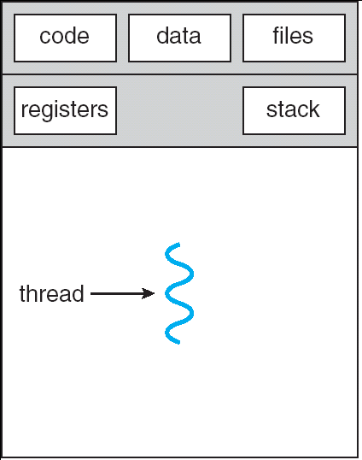
IPC: Overview
Communication is harder between processes
To allow it: inter-process communication is applied
  Create a shared mailbox(es) at either the process or the kernel
Single-Threaded Process
Single-Threaded Process

Slide 69
IPC: Overview
FOUR Primitive Setup:
  Create_mailbox
  Delete_mailbox
  Connect
  Disconnect
THREE Primitive Operations:
  send (destination, message)
  receive (source, message)
  broadcast (mailbox, message)

Slide 70
IPC: Overview
Synchronization:
  Communication requires synchronization
    Sender must send before receiver can receive
  What happens to a process after it issues a send/receive primitive?
    Sender and receiver may or may not be blocking (waiting for message)
  Non-Blocking send, Blocking receive
    Sender continues on
    Receiver is blocked until the requested message arrives
    (+) Most useful combination.
    (-) Programmer is responsible to determine that a message has been received

Slide 71
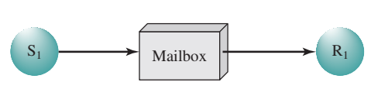
IPC: Overview
Addressing:
  Sending process need to be able to specify which process should receive the message
Direct addressing
        Send primitive includes a specific identifier of the dest process
        Receive primitive know ahead of time which process a message is expected
Indirect Addressing
        Msg’s are sent to a shared data structure consisting of queue
        Queue is called mailbox
        One process sends a msg to the mailbox and the other process picks up the msg from the mailbox

Slide 72
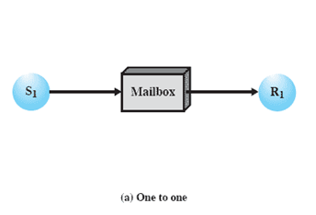
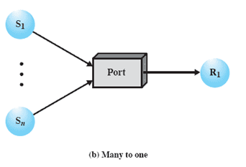
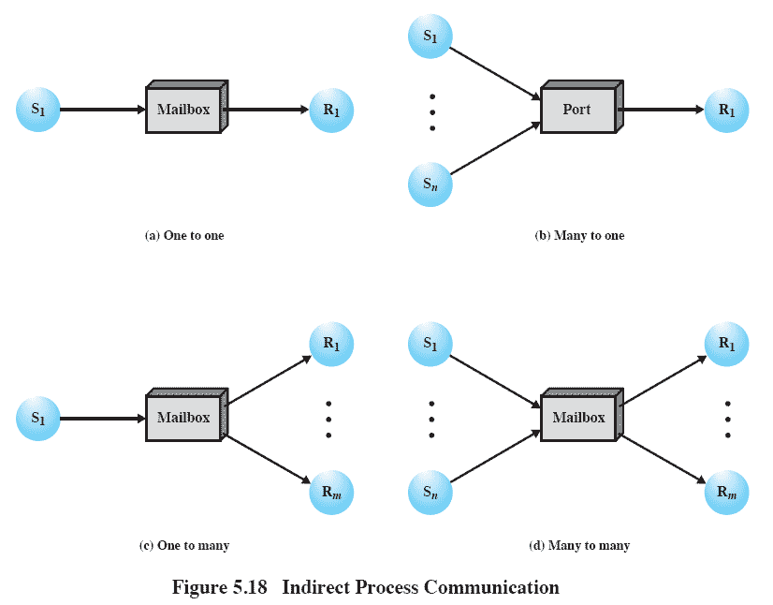
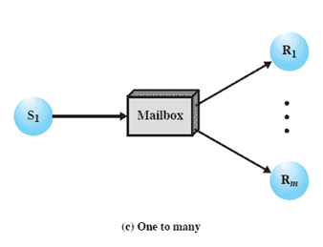
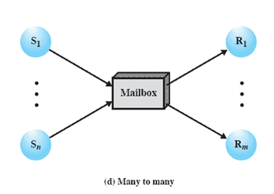
IPC: Overview
By Dest Env
By Dest Env
Indirect Addressing:
  Communication Type
    IPC#1: one-to-one & many-to-one
    IPC#2: one-to-many & many-to-many
  Mailbox Ownership:
    IPC#1: By created process (e.g. port)
    IPC#2: By OS
By OS
By OS
IPC#1
IPC#2
1-1: allows a private communications
1-M: Useful for msg/ info broadcast
M-1: Useful for client-server interaction
M-N: Allows services from multi server proc’s to multi client

Slide 73
IPC: Overview
Message Format:
Header
      Control Info: senderID, receiverID, type
Body
      Data: as stream of bytes
      Length

Slide 74
IPC#1 (private mailbox)
PART III: INDIVIDUAL module #4

Slide 75
IPC#1
The main functions required to implement IPC#1 are:
# | Function | File
1 | ipc_create_data_message | [USER SIDE] Declarations: inc/ipc.h definitions TO DO: lib/ipc.c
2 | ipc_send
3 | ipc_receive
4 | ipc_create_env_mailbox | [KERNEL SIDE] Declarations: kern/ipc/ipc.h definitions TO DO: kern/ipc/ipc.c
5 | ipc_delete_env_mailbox
6 | sys_ipc_send
7 | sys_ipc_receive
NOTE: MOST of them are direct/small functions

Slide 76
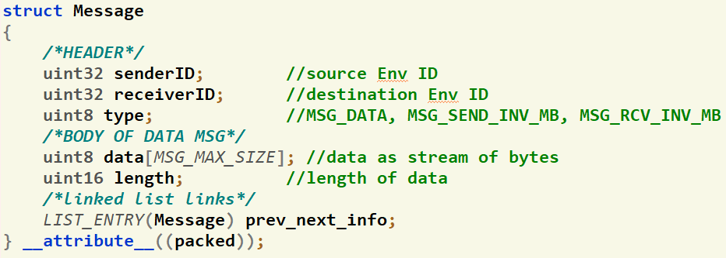
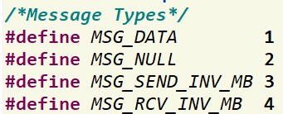
IPC#1: Given Data Structures
Struct declaration of the Message (inc/ipc.h)
Struct declaration of the MessageList (inc/ipc.h)
Message types

Slide 77
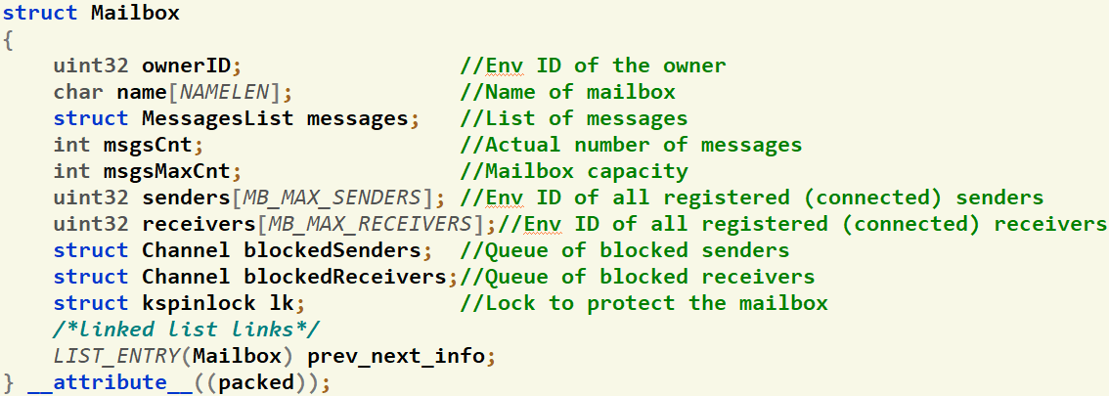
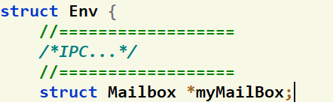
IPC#1: Given Data Structures
Struct declaration of the Mailbox (kern/ipc/ipc.h)
Local (private) mailbox of the environment
(inc/environment_definitions.h)

Slide 78
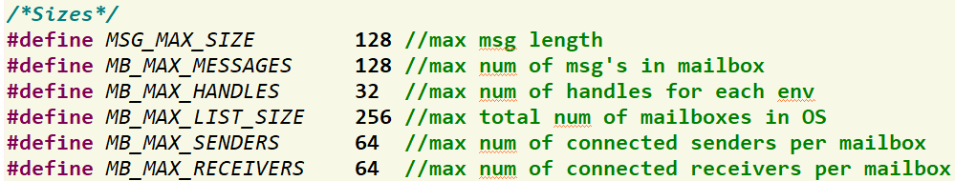
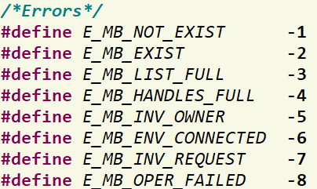
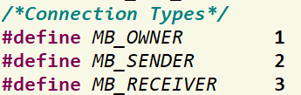
IPC#1: Given Data Structures
Max limits... (inc/ipc.h)
Possible error codes... (inc/ipc.h)
Connection types... (inc/ipc.h)

Slide 79
IPC#1: IMPORTANT NOTE
REMEMBER
During your solution, any SHARED data need to be PROTECTED by critical section via LOCKS

Slide 80
#1: Create Message
IPC#1: Required Functions
lib/ipc.c
int ipc_create_data_message(uint8 *data, uint16 length, struct Message* msg)
Description:
  Set “Data” section of the given msg by the given info
  Note: msg is a return param (passed by reference)
  if invalid length, return E_MB_INV_MSG and set msg to NULL

Slide 81
#2: Create Env Mailbox
IPC#1: Required Functions
kern/ipc/ipc.c
int ipc_create_env_mailbox(struct Env *e, uint32 mailboxSize)
Description:
  Allocate a new mailbox for the given env and set its myMailbox
  Initialize its fields
  If allocation failed, return E_NO_MEM
  Note: this function already called in initialize_environment(...)

Slide 82
#3: Delete Env Mailbox
IPC#1: Required Functions
kern/ipc/ipc.c
int ipc_delete_env_mailbox(struct Env *e)
Description:
  Destroy all messages in the queue
  Send MSG_SEND_INV_MB to all blocked senders at their local mailboxes
  Awaken all blocked senders (if any)
  Reset mailbox members (name, ownerID,...)
  Delete its object

Slide 83
#4: Send [USER SIDE]
IPC#1: Required Functions
lib/ipc.c
int ipc_send(uint32 destMailboxHandle, struct Message *msg)
Description:
  Validate the message by
    Checking its length vs max allowed length
    Validate senderID of the msg to be set correctly
  If not valid: return E_MB_OPER_FAILED
  Call sys_ipc_send()
  Panic if it returns error

Slide 84
#5: Send [KERNEL SIDE]
IPC#1: Required Functions
kern/ipc/ipc.c
int sys_ipc_send(uint32 destMailboxHandle, struct Message *msg)
Description:
  Get mailbox as follows:
    If destMailboxHandle = 0: get local mailbox of the destination env (specified in msg header)
      Hint: use envid2env() to get the corresponding env from a given envID
    Else: call ipc_get_mailbox (it returns mailbox by reference)
  If mailbox is full, block on “senders” channel
  Copy message data to a new message at kernel (during copy: take care of the message type)
  Enqueue the new message to the mailbox and wake-up a blocked receiver (if any)
  Return:
  0 on success.
  E_MB_NOT_EXIST if mailbox handle not exist.
  E_MB_INV_REQUEST: if the env is not registered in the mailbox as a sender

Slide 85
#6: Receive [USER SIDE]
IPC#1: Required Functions
lib/ipc.c
int ipc_receive(uint32 srcMailboxHandle, struct Message *msg)
Description:
  Validate the message by
    Checking its length vs max allowed length
    Validate receiverID of the msg to be set correctly. Either: = current env OR = UINT_MAX if broadcast
  If not valid: return E_MB_OPER_FAILED
  Call sys_ipc_receive()
  Panic if it returns error

Slide 86
#7: Receive [KERNEL SIDE]
IPC#1: Required Functions
kern/ipc/ipc.c
int sys_ipc_receive(uint32 srcMailboxHandle, struct Message *msg)
Description:
  Get mailbox as follows:
    If srcMailboxHandle = 0: get local mailbox of the source env (specified in msg header)
      Hint: use envid2env() to get the corresponding env from a given envID
    Else: call ipc_get_mailbox (it returns mailbox by reference)
  If mailbox is empty, block on “receivers” channel
  Dequeue a message from the mailbox and wake-up a blocked sender (if any)
  If it’s last message, wake-up ALL blocked senders
  Copy the message to the passed msg from user and destroy it (during copy: take care of the message type)
  Return:
  0 on success.
  E_MB_NOT_EXIST if mailbox handle not exist.
  E_MB_INV_REQUEST: if the env is not registered in the mailbox as a receiver

Slide 87
IPC#2 (public mailbox)
PART III: INDIVIDUAL module #5

Slide 88
IPC#2
The main functions required to implement IPC#2 are:
# | Function | File
1 | ipc_broadcast | [USER SIDE] definitions TO DO: lib/ipc.c
2 | ipc_get_mailbox | [KERNEL SIDE] Declarations: kern/ipc/ipc.h definitions TO DO: kern/ipc/ipc.c
3 | sys_ipc_create_mailbox
4 | sys_ipc_delete_mailbox
5 | sys_ipc_connect
6 | sys_ipc_disconnect
7 | sys_ipc_broadcast
NOTE: MOST of them are direct/small functions

Slide 89
IPC#1: Given Data Structures
Struct declaration of the Message (inc/ipc.h)
Struct declaration of the MessageList (inc/ipc.h)
Message types

Slide 90

IPC#2: Given Data Structures
Struct declaration of the Mailbox (kern/ipc/ipc.h)
List of ALL created public Mailbox’s in the Kernel (kern/ipc/ipc.h)

Slide 91
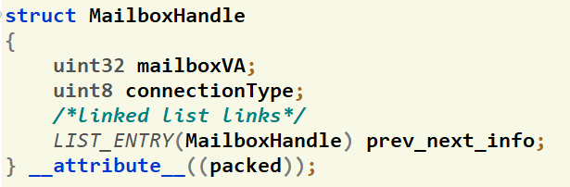
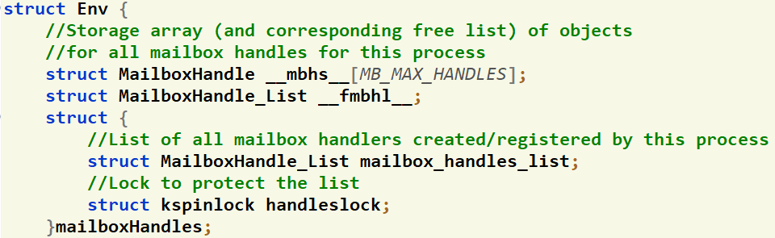
IPC#2: Given Data Structures
Struct declaration of the MailboxHandle (inc/environment_definitions.h)
  Contains info about connected (or owned) mailbox of the env
List of MailboxHandle’s of all connected (or owned) mailboxes for each env (inc/environment_definitions.h)
Local storage for available MailboxHandle objects for this env

Slide 92
IPC#2: Given Data Structures
Max limits... (inc/ipc.h)
Possible error codes... (inc/ipc.h)
Connection types... (inc/ipc.h)

Slide 93
IPC#2: Given Functions
Allocate MailboxHandle object from the env storage (kern/ipc/ipc.c)
struct MailboxHandle* allocate_mailbox_handle(struct Env* e)
Free MailboxHandle object by returning it to the env storage (kern/ipc/ipc.c)
void free_mailbox_handle(struct Env* e, struct MailboxHandle* mailboxHandle)
Create/Delete mailbox [USER SIDE] (lib/ipc.c)
int ipc_create_mailbox(char *mailboxName)
int ipc_delete_mailbox(uint32 mailboxHandle)
Connect/Disconnect to/from mailbox [USER SIDE] (lib/ipc.c)
int ipc_connect(uint32 ownerID, char *mailboxName, uint8 connectType)
int ipc_disconnect(uint32 mailboxHandle)

Slide 94
IPC#2: IMPORTANT NOTE
REMEMBER
During your solution, any SHARED data need to be PROTECTED by critical section via LOCKS

Slide 95
#1: Create Mailbox [KERNEL SIDE]
IPC#2: Required Functions
kern/ipc/ipc.c
int sys_ipc_create_mailbox(char *mailboxName)
Description:
  Allocate a new Mailbox and a new MailboxHandle for the given env
  Initialize their fields
  Add each one to the corresponding list (Mailbox at Kernel, MailboxHandle at Env)
  Return:
  If success: handle (i.e. address of the allocated handle after masking-out its msb to make it +ve)
  E_MB_EXIST: if mailbox exists in the list
  E_MB_LIST_FULL: if mailbox list is full
  E_MB_HANDLES_FULL: if list of handles for this env is full
  E_NO_MEM: if failed to allocate a new mailbox

Slide 96
#2: Delete Mailbox [KERNEL SIDE]
IPC#2: Required Functions
kern/ipc/ipc.c
int sys_ipc_delete_mailbox(uint32 mailboxHandle)
Description:
  Get mailbox object using its handle (use ipc_get_mailbox())
  Destroy all messages in the queue
  Unregister (disconnect) all registered senders & receivers by removing this mailbox from their list of handles (Hints: Use envid2env(). Use free_mailbox_handle())
  Send MSG_SEND_INV_MB to all blocked senders at their local mailboxes
  Send MSG_RCV_INV_MB to all blocked receivers at their local mailboxes
  Awaken all blocked senders and receivers (if any)
  Remove mailbox from the list & Reset its members (name, ownerID,...)
  Delete its object
  Return: 0 on success. E_MB_NOT_EXIST if mailbox handle not exist. E_MB_INV_OWNER if invalid owner

Slide 97
#3: Connect Mailbox [KERNEL SIDE]
IPC#2: Required Functions
kern/ipc/ipc.c
int sys_ipc_connect(uint32 ownerID, char *mailboxName, uint8 connectType)
Description:
  Search the Mailbox List for the given name & owner
  Register the env in the corresponding array of mailbox (according to connectType)
  Register the mailbox (its VA) and connection type in the list of handles of the current env
      Hint: use allocate_mailbox_handle()
  Return:
  If success: handle (i.e. address of the allocated handle after masking-out its msb to make it +ve)
  E_MB_NOT_EXIST: if mailbox not exists in the list
  E_MB_INV_REQUEST: if the env is the owner of the mailbox
  E_MB_HANDLES_FULL: if list of handles for this env is full

Slide 98
#4: Disconnect Mailbox [KERNEL SIDE]
IPC#2: Required Functions
kern/ipc/ipc.c
int sys_ipc_disconnect(uint32 mailboxHandle, uint8 connectType)
Description:
  Get mailbox object using its handle (use ipc_get_mailbox())
  Unregister the env from the corresponding array in mailbox (based on connectType)
  Remove it from the env list of handles (remember to free the handle object)
  Return:
  0 on success.
  E_MB_NOT_EXIST if mailbox handle not exist.
  E_MB_INV_REQUEST: if the env is the owner of the mailbox
  E_MB_INV_REQUEST: if the env is not registered in the mailbox

Slide 99
#5: Get Mailbox [KERNEL SIDE]
IPC#2: Required Functions
kern/ipc/ipc.c
int ipc_get_mailbox(uint32 mailboxHandle, struct Mailbox *mb)
Description:
  Get mailbox object using the info from the given handle "mb" is a return param (passed by reference)
  Check the list of handles of the current env for the given handle (after setting its msb to 1)
      by validating the address of mailbox Handle vs address of each list element
  Get corresponding mailbox from the handle
  Validate the connection type by applying the correct check
      If owner: validate ownership! Else, check the array of registered senders/receivers
  Return:
  0 on success.
  E_MB_NOT_EXIST if mailbox handle not exist.
  E_MB_INV_OWNER if invalid owner
  E_MB_INV_REQUEST: if the env is not registered in the mailbox

Slide 100
#6: Broadcast [USER SIDE]
IPC#2: Required Functions
lib/ipc.c
int ipc_broadcast(uint32 destMailboxHandle, struct Message *msg)
Description:
  Validate the message by
    Checking its length vs max allowed length
    Validate senderID & receiverID of the msg to be set correctly (sender = current env, receiver = UINT_MAX)
  If not valid: return E_MB_OPER_FAILED
  Call sys_ipc_broadcast()
  Panic if it returns error

Slide 101
#7: Broadcast [KERNEL SIDE]
IPC#2: Required Functions
kern/ipc/ipc.c
int sys_ipc_broadcast(uint32 destMailboxHandle, struct Message *msg)
Description:
  Get mailbox object using its handle (use ipc_get_mailbox())
  For each registered receiver at this mailbox
      Skip the env if its local mailbox is full
      Copy message data to a new message at kernel (during copy: take care of the message type)
      Enqueue the new message to the local mailbox of the env and wake-up it (if blocked)
  Return:
  on success: number of env that failed to send the message to them.
  E_MB_NOT_EXIST if mailbox handle not exist.
  E_MB_INV_REQUEST: if the env is not registered in the mailbox as a sender

Slide 102
Shared Memory
PART III: INDIVIDUAL module #6

Slide 103
Project Overview
[TW] Prerequisite Modules
Dyn. Alloc, Kern Heap, Fault Handl. 1, Blocking
[M#1]
Fault Handl. 2
[M#5]
IPC #2
Individual Module#1
Individual Module#2
[M#2]
User Heap
Individual Module#3
Individual Module#4
[M#6]
Shared Memory
[M#3]
CPU Sched.
[M#4]
IPC #1
[TW] Integration & Overall Testing
Scenarios & Bonuses
Notes:
Inshaa’ALLAH

Slide 104
Objective
Allow the two or more user processes to share any kind of data among them during the run-time

Slide 105
Shared Memory
DEPENDENCIES: Dynamic Allocator
REMEMBER
During your solution, any SHARED data need to be PROTECTED by critical section via LOCKS

Slide 106
Shared Memory
The main functions required to handle “Shared Memory” are:
# | Function | File
1 | smalloc | [USER SIDE] Functions definitions TO DO in: lib/uheap.c
2 | sget
3 | alloc_share | [KERNEL SIDE] Functions definitions TO DO in: kern/mem/shared_memory_manager.c
4 | get_share_info
5 | create_shared_object
6 | get_shared_object

Slide 107
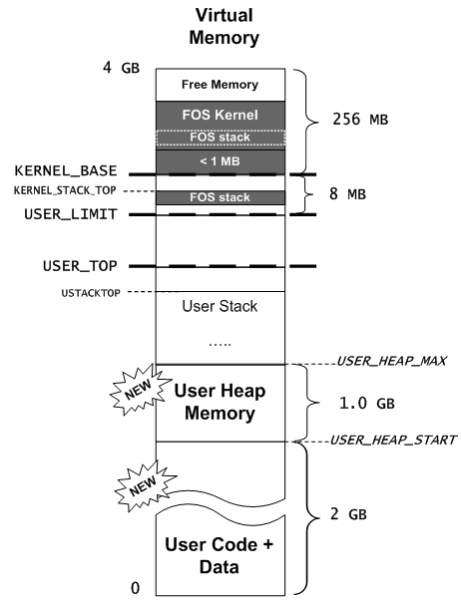
Shared Memory: Overview
Communication is harder between processes
To allow it: shared memory is applied
  Create and share objects in the PAGE ALLOCATOR of USER HEAP
  CUSTOM FIT Strategy
Shared
Single-Threaded Process
Single-Threaded Process

Slide 108
Shared Memory: Overview
Creation (Application 1):
  int* ptr_sharedInt;
  uint8 isWritable = 1;
  ptr_sharedInt = smalloc(“mySharedInt”,4,isWritable);
    allocate 4 bytes named “mySharedInt” in virtual memory and return the allocated virtual address to “ptr_sharedInt”
    Specify its shared permission to be writable
  *ptr_sharedInt = 70;
    Set the value of the shared int to 70

Slide 109
Shared Memory: Overview
Access from other app. (Application 2):
  int* ptr_sharedInt;
  ptr_sharedInt = sget(App1ID, “mySharedInt”);
    Search for the shared object, named “mySharedInt” and belong to App1ID
    share it in app2, and return its virtual address in “ptr_sharedInt”
  int sharedInt = *ptr_sharedInt;
    Read its value (it should be 70)

Slide 110
Shared Memory: Overview
Create/Share pages on 4KB granularity
.
.
.
ptr3 = sget(ownerID, “z”)
ptr3
3 KB
ptr2 = smalloc(“y”, 1 KB, 0)
ptr2
1 KB
2 KB
4 KB
ptr1 = smalloc(“x”, 6 KB, 1)
ptr1
.
.
.
PAGE ALLOCATOR
USER_HEAP_START

Slide 111
Shared Memory: Overview
USER_HEAP_MAX
.
.
.
UNUSED
ptr1 = smalloc(“x”, 1MB, 1)
UNUSED
CUSTOM FIT Strategy
1. Search for EXACT fit
2. if not found,
search for WORST fit till break
3. if not found,
extend BREAK if available
4. if not available,
return NULL
Required Complexity: bounded by
O(# FREE areas + # required pages)
ptr2 = sget(ownerID1, “y”)
ptr3 = smalloc(“y”, 3MB, 0)
uheapPageAllocBreak
ptr4= malloc(1.5 MB)
2 MB
FREE
2 MB
ptr5
2.5 MB
ptr5=sget(ownerID2, “s”)
1 MB
ptr1 = smalloc(“x”, 1MB, 1)
ptr1
1 MB
1 MB
1 MB
ptr3 = smalloc(“y”, 3MB, 0)
3 MB
ptr3
4 MB
ptr2 = sget(ownerID1, “y”)
ptr2
1 MB
2 MB
FREE
3 MB
ptr4= malloc(1.5 MB)
ptr4
1.5 MB
4 MB
uheapPageAllocStart
x = malloc (12 KB)
O(2 + 12KB/4KB)

Slide 112
Shared Memory: Details
1. Space MUST be allocated in RAM
2. KEEP track of the allocated frames
smalloc(): Store allocated frames for later use
x = smalloc(“x”, 6 KB, 1)
Share Object 1
y = smalloc(“y”, 2 KB, 1)
Virtual.1
RAM
OwnerID=Env1ID,
Name = “x”, Size = 6 KB, …
.
.
.
…
100
30
Frames Storage
Share Object 2
OwnerID=Env1ID,
Name = “y”, Size = 2 KB, …
y
2 KB
…
4 KB
4 KB
F# 100
99
Frames Storage
2 KB
F# 99
2 KB
4 KB
…
PAGE ALLOCATOR
x
30
99
100
.
.
.
...
R=1
…….
R=1
R=1
...
2 KB
F# 30
frames_info
…

Slide 113
Shared Memory: Details
sget(): Share the stored frame of the object.
Share Object 2
[Virt.2] y2 = sget(env1ID, “y”)
Share Object 1
[Virt.2] x2 = sget(env1ID, “x”)
[Virt.3] y3 = sget(env1ID, “y”)
OwnerID=Env1ID,
Name = “x”, Size = 6 KB, …
Virtual.1
Virtual.2
OwnerID=Env1ID,
Name = “y”, Size = 2 KB, …
Virtual.3
RAM
.
.
.
.
.
.
.
.
.
…
Frames Storage
100
Frames Storage
99
30
y
2 KB
4 KB
4 KB
F# 100
2 KB
4 KB
F# 99
2 KB
x2
2 KB
2 KB
y3
4 KB
4 KB
…
x
y2
2 KB
30
99
100
.
.
.
.
.
.
.
.
.
...
R=1
…….
R=1
R=1
...
R=2
R=3
R=2
R=2
2 KB
F# 30
frames_info
…

Slide 114
Shared Memory: Data [GIVEN]
struct Share {
/*Global Info*/
//Unique ID for this Share object
//Should be set to VA of created object after masking most significant bit (to make it +ve)
int32 ID ;
char name[NAMELEN]; //share name
int32 ownerID ; //ID of the owner environment
  int size; //share size
  /*OS Info*/
  uint32 references; //references, number of envs looking at this shared mem object
  uint8 isWritable; //sharing permissions (0: ReadOnly, 1:Writable)
  struct FrameInfo** framesStorage; //to store frames to be shared
struct ShareHandle* handle; //Pointer to the corresponding handle in the env
  LIST_ENTRY(Share) prev_next_info; // list link pointers
}
kern/mem/shared_memory_manager.h

Slide 115
Shared Memory: Data [GIVEN]
kern/mem/shared_memory_manager.h
//List of all shared objects
LIST_HEAD(Share_List, Share); // Declares 'struct Share_List’
struct
{
struct Share_List shares_list ; //List of all share variables created by any process
struct spinlock shareslock; //Use it to protect the shares_list in the kernel
} AllShares;
GENERAL NOTE: make sure to protect shares_list using its lock

Slide 116
Shared Memory: Data [GIVEN]
inc/environment_definitions.h
struct ShareHandle
//Used to store info about the created shared objects inside each env
{
  //share name
  char name[NAMELEN];
  //Unique ID for this Share object
  int32 ID ;
  // list link pointers
  LIST_ENTRY(ShareHandle) prev_next_info;
} __attribute__((packed));

Slide 117
Shared Memory: Data [GIVEN]
inc/environment_definitions.h
struct Env{
//storage of shareHandles inside each env
  //Storage array & corresponding free list of objects for all share handles for this process
  struct ShareHandle __shs__[SHARE_MAX_HANDLES];
  struct ShareHandle_List __fshl__;//List of all free share handles
  struct
  {
    //List of all share handles created by this process
    struct ShareHandle_List share_handles_list;
    //Lock to protect the list
    struct kspinlock handleslock;
  }shareHandles;
Local storage for available ShareHandle objects for this env

Slide 118
Shared Memory: Functions [GIVEN]
kern/mem/shared_memory_manager.c
void sharing_init() (DONE)
Initialize the shares list & its lock
ALREADY called for you ☺
int find_share(int32 ownerID, char* name) (DONE)
Search for the given shared object in the "shareHandles" of the owner env
If found: return ID of the Share object, else: return E_SHARED_MEM_NOT_EXISTS

Slide 119
Shared Memory: Functions [GIVEN]
kern/mem/shared_memory_manager.c
struct ShareHandle* allocate_share_handle(struct Env* e) (DONE)
Allocate ShareHandle object from the local storage of the given env
If found: return pointer to the allocated ShareHandle object, else: return NULL
void free_share_handle(struct Env* e, struct ShareHandle* shareHandle) (DONE)
Free shareHandle object by adding it to the local storage of the given env

Slide 120
#1: Allocate & Initialize Share Object
kern/mem/shared_memory_manager.c
struct Share* alloc_share(int32 ownerID, char* shareName, uint32 size, uint8 isWritable)
Allocate a new shared object
Initialize its members:
  references = 1,
  ID = VA of created object after masking-out its most significant bit
Create the "framesStorage“: array of pointers to struct FrameInfo to save pointer(s) to the shared frame(s)
Initialize it by ZEROs
Return:
  If succeed: pointer to the created object for struct Share
  If failed: UNDO any allocation & return NULL

Slide 121
#2: Get Share Info
kern/mem/shared_memory_manager.c
int get_share_info(int32 ownerID, char* shareName, int *size)
Search the handles of the owner env for the given share
Hint: use envid2env() to get the corresponding env from a given envID
Return:
  If found: return its ID and set size by its size
  Else: return E_SHARED_MEM_NOT_EXISTS and set size to 0

Slide 122
#3: smalloc()
  [USER SIDE] lib/uheap.c
Apply CUSTOM FIT strategy to search the PAGE ALLOCATOR in user heap for suitable space to the required allocation size (on 4 KB BOUNDARY)
if no suitable space found, return NULL
Call sys_create_shared_object(...) to invoke the Kernel for allocation of shared variable
RETURN:
If successful, return its virtual address
Else, return NULL
void* smalloc(char *sharedVarName, uint32 size, uint8 isWritable)

Slide 123
#4: create_shared_object()
  [KERNEL SIDE] kern/mem/shared_memory_manager.c
int create_shared_object(int32 ownerID, char* shareName, uint32 size, uint8 isWritable, void* virtual_address)
Allocate and Initialize a new share object ➔ Add it to the “shares_list”
Allocate and Initialize the shareHandle ➔ Add it to the env shareHandles List
Allocate ALL required space in the physical memory on a PAGE boundary
Map them on the given "virtual_address" on the current process with WRITABLE permissions
Add each allocated frame to "frames_storage" of this shared object to keep track of them for later use
RETURN:
  ID of the shared object (its VA after masking out its msb) if success
  E_SHARED_MEM_EXISTS if the shared object already exists
  E_NO_SHARE if failed to create a shared object
  E_NO_SHARE_HANDLE if failed to create a shareHandle object

Slide 124
#5: sget()
  [USER SIDE] lib/uheap.c
Get the info (ID & size) about the shared variable (use sys_get_share_info())
Apply CUSTOM FIT strategy to search the heap for suitable space (on 4 KB BOUNDARY)
Call sys_get_shared_object(...) to invoke the Kernel for sharing this variable
RETURN:
If successful, return its virtual address
If not exist, return NULL
If no space, return NULL
void* sget(int32 ownerEnvID, char *sharedVarName)

Slide 125
#6: get_shared_object()
  [KERNEL SIDE] kern/mem/shared_memory_manager.c
Get virtual address of the Share object (by setting msb to 1)
Validate the Share object by checking its ID vs the passed one
Get its physical frames from the “frames_storage”
Share these frames with the current process starting from the given "virtual_address"
Use the flag isWritable to make the sharing either read-only OR writable
Update references
RETURN:
0 if success
E_SHARED_MEM_NOT_EXISTS if the shared object is NOT exists
int get_shared_object(int32 shareID, void* virtual_address)

Slide 126

FINALLY, LET’S RUN THE ENTIRE FOS...
☺ Enjoy developing your own OS ☺

